Slide 1
Employee Management System using
Web Assembly
- The 404’s
CRUD Operations
Apoorav Singh
Yash Khopkar
Notes:
This slide contains the editable pieces that were used to build infographic sample
Icons – Eye, PC

Slide 2
An Employee Management System to be used by Organizations. An Admin role where the Admin can create Employees and assign usernames and passwords. The Employess can the Log In using their credentials and look at the discounted products.
Project
Description
Notes:
This slide contains the editable pieces that were used to build infographic sample
Icons – Eye, PC

Slide 3
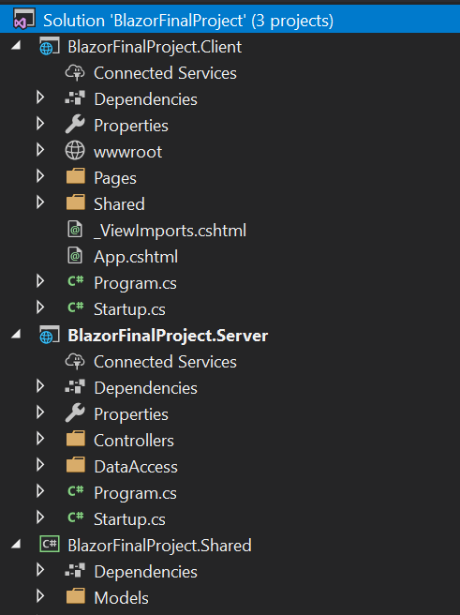
Project Structure
Notes:
This slide contains the editable pieces that were used to build infographic sample
Icons – Eye, PC

Slide 4
Top Features
Role based access
CRUD operations
MongoDB database
Discounted products page for employees
Notes:
This slide contains the editable pieces that were used to build infographic sample
Icons – Eye, PC

Slide 5
Role Based Access
Admin can login and Create Employees
Employees have to use the credentials assigned to them by admin to Log into the system
And eventually they can access the Product page
Notes:
This slide contains the editable pieces that were used to build infographic sample
Icons – Eye, PC

Slide 6
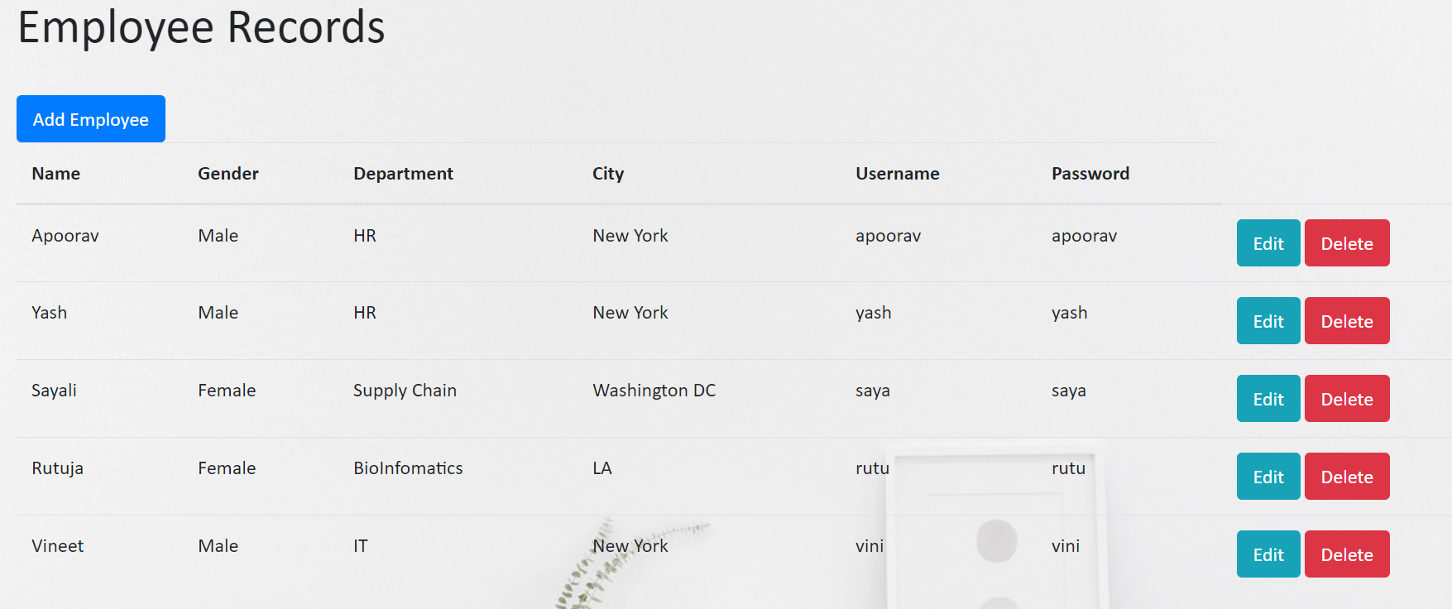
Admin
Landing
Page
Notes:
This slide contains the editable pieces that were used to build infographic sample
Icons – Eye, PC

Slide 7
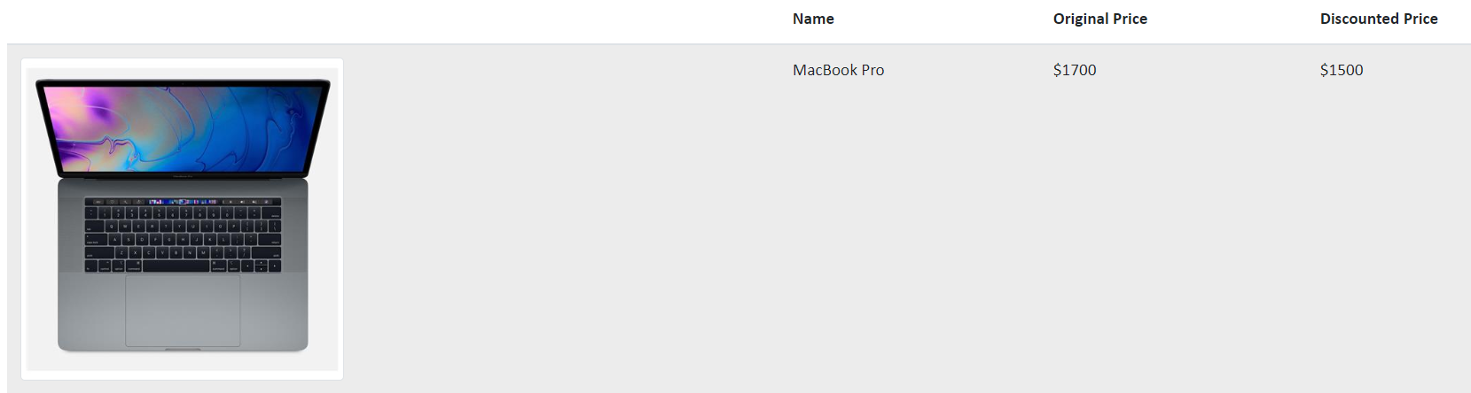
Employee
Landing
Page
Notes:
This slide contains the editable pieces that were used to build infographic sample
Icons – Eye, PC

Slide 8
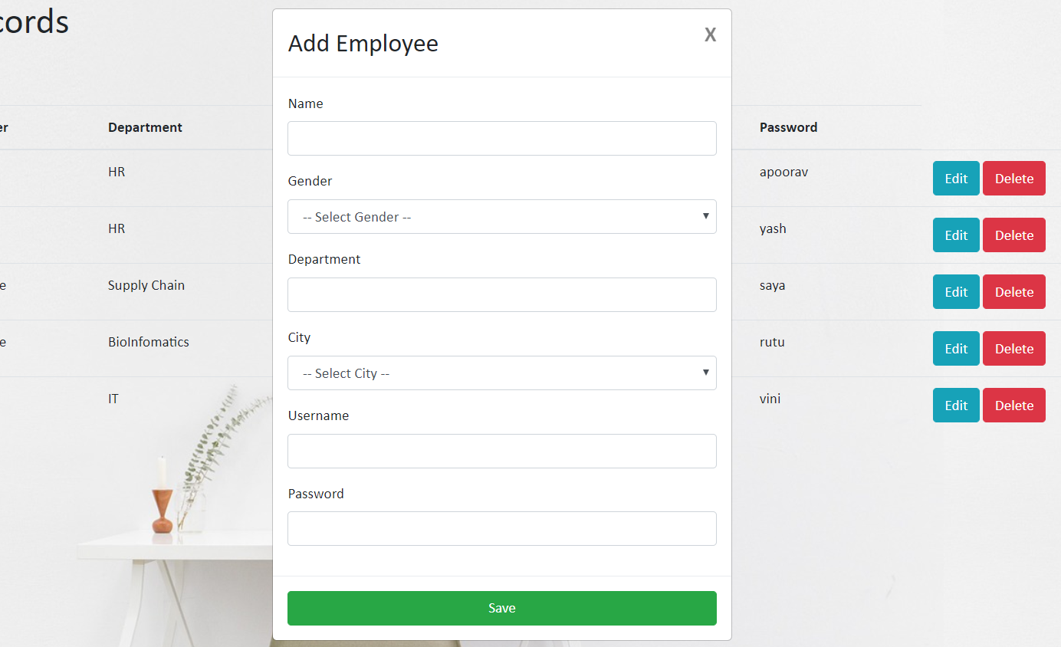
CRUD
Operations
Notes:
This slide contains the editable pieces that were used to build infographic sample
Icons – Eye, PC

Slide 9
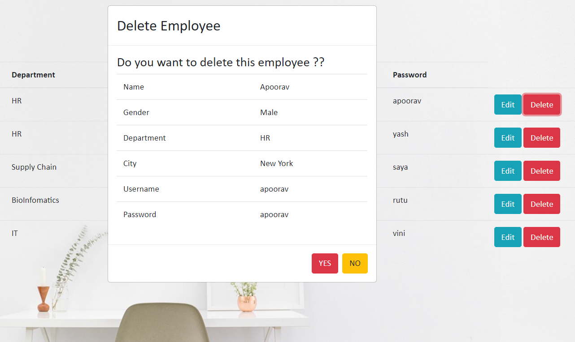
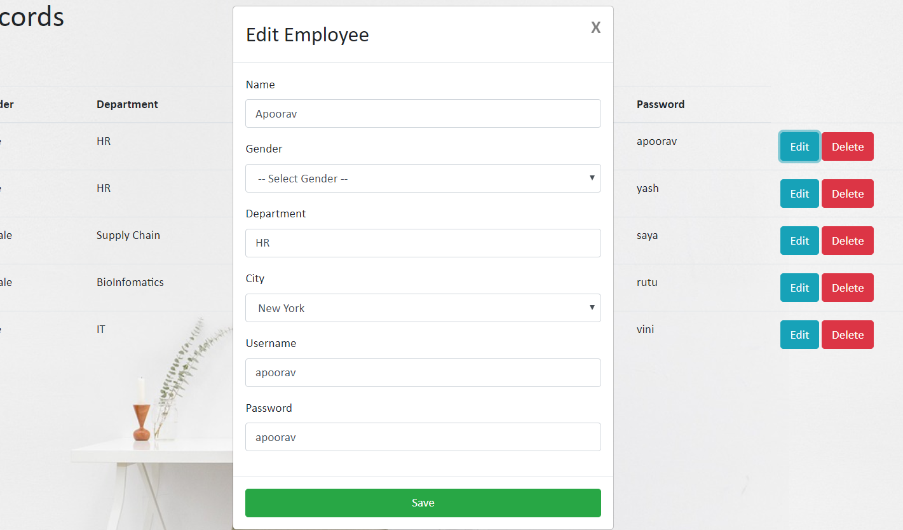
Notes:
This slide contains the editable pieces that were used to build infographic sample
Icons – Eye, PC

Slide 10
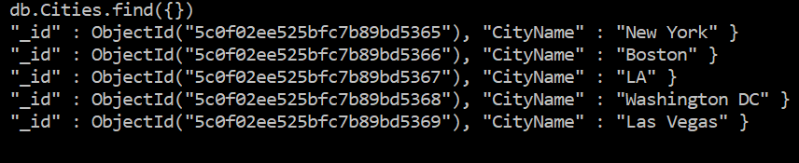
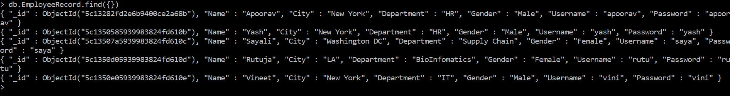
Our Database contains two collections: EmployeeRecord and Cities
MongoDB
Database
Notes:
This slide contains the editable pieces that were used to build infographic sample
Icons – Eye, PC

Slide 11
Future
Scope
Deployment in AWS?
Notes:
This slide contains the editable pieces that were used to build infographic sample
Icons – Eye, PC

Slide 12
Demo.
Notes:
This slide contains the editable pieces that were used to build infographic sample
Icons – Eye, PC

Slide 13
Acknowledgement
We would like to thank Professor Dino and Neha for their continued support
Notes:
This slide contains the editable pieces that were used to build infographic sample
Icons – Eye, PC

